Slide 1
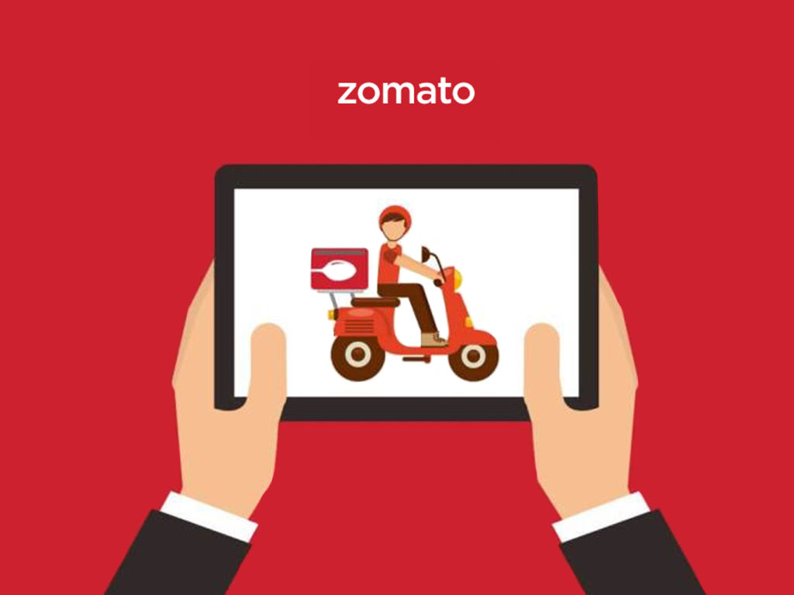
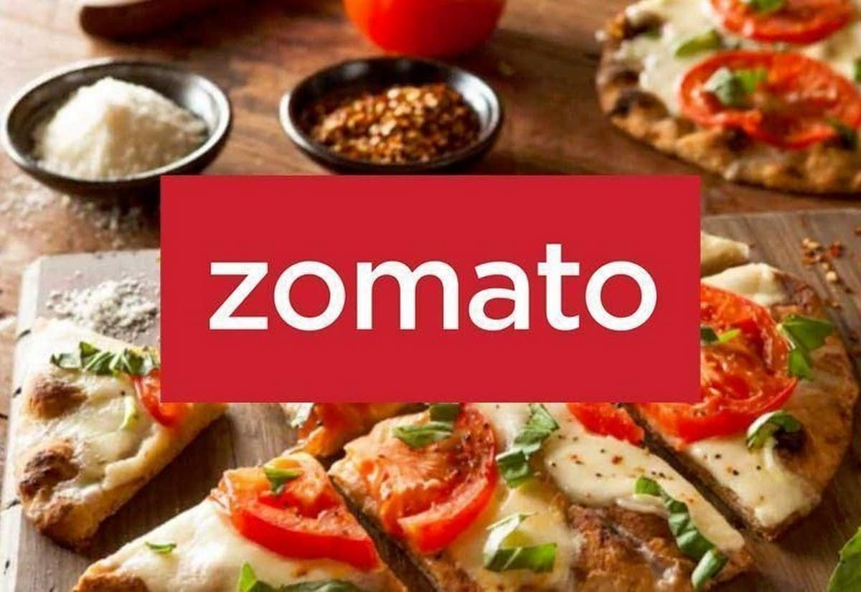
Zomato Analysis
Team Members Mail IDs Phone Numbers
Anant Tyagi aananttyagi007@gmail.com 7838236785
Ashutosh Rana ashutosh.20scse1010802@galgotiasuniversity.edu.in 8445783337
Ayush Chhoker ayushchhoker15@gmail.com 84680 36200
Ishan Gupta ishan.20scse1010804@galgotiasuniversity.edu.in 9205976300
Prabhat Singh Tiwari kumar.prabhat110023@gmail.com 7419199550
Vedangi Sharma vedangi001@gmail.com 9560527960

Slide 2

Content
Purpose of the Project
Project Summary
Data procurements and Data Sources
Data Wrangling
General Exploratory Data Analysis
Analysis of Famous Chains in India
Cost wise EDA
High Rated Restaurants EDA
Maximum Voted Restaurant in Each City
Power BI Dashboard
Predictive Analysis
Conclusion

Slide 3

Purpose of the project
Zomato is one of the most used food delivery apps. It provides its service in 25 Countries. It allows you the convenience to sit back at home and search for any cuisine, restaurant, or even dish you like! You can search up the menu, pictures of the restaurant/dish, directions, map view, contact details, and the different filters. One can always Rate, Review, and give feedback to the restaurant.
This project aims to analyze the data of Zomato for various cities (e.g. Bengaluru, Delhi, etc.) of India. The dataset includes the ratings, votes, services, cuisines,etc. provided by the various shops. The study was done in such a way, that it will be easier for the customers to find a suitable restaurant in near area.
The analysis also includes the comparison between various cities. Some common brands in all different cities can be analysed to understand, overall whose services and popularity is better than others.

Slide 4

Purpose of the project
Descriptive Analysis :
General EDA about the dataset.
Top Restaurant Chain in India
Cost-Wise Analysis of the Restaurants
High – rated Restaurants
Top Restaurants city wise
Predictive Analysis
1. Prediction of Aggregate-Rating
2. Prediction of Average Cost

Slide 5


Project summary
Project summary
Zomato data Analysis is one of the most useful analyses for foodies who want to taste the best cuisines of every part of India which lies in their budget. This analysis is also for those who want to find value-for-money restaurants in various parts of the country for cuisines.
Data Collection
The data was collected from Kaggle. The raw dataset which is used has 2 lakh rows and 26 columns in starting which is then Passed to second stage of the project.
Data Wrangling
The raw data had many duplicate values, many null values, and needs formatting to make it ready for Analysis.
Exploratory Data Analysis
EDA is the main part in data analysis, in this project the major analysis was done using python libraries. Various plots were made to find deeper insights of the data.
Dashboard
Dashboard plays a very important role in making live visualization reports. Power BI dashboard was made in order to easily understand the data.
Predictive Analysis
The models are trained and later use for predicting the aggregate rating and average cost of the cafes.

Slide 6
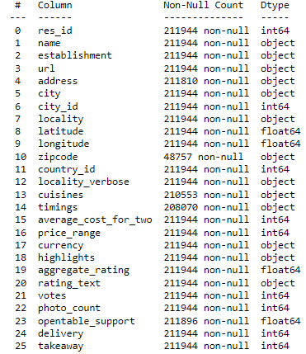
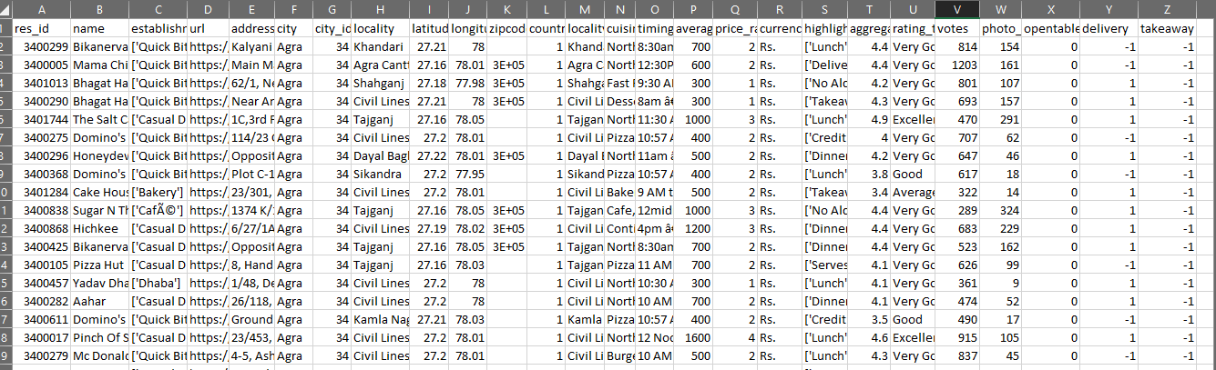
Data Procurement and data sources
Various data sources were searched and collected. The aim was to obtain the latest data having enough features, which can provide better insights. Following is the source of the datasets which was finalized
https://www.kaggle.com/datasets/rabhar/zomato-restaurants-in-india?resource=download&select=zomato_restaurants_in_India.csv
The raw dataset has 211994 rows and 26 features.

Slide 7

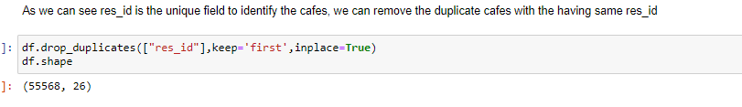
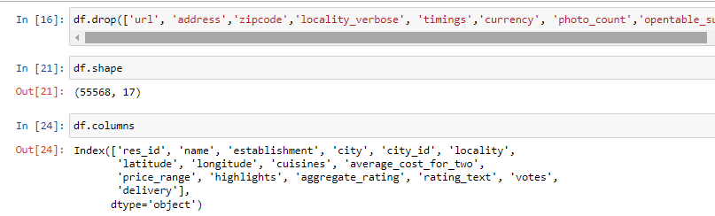
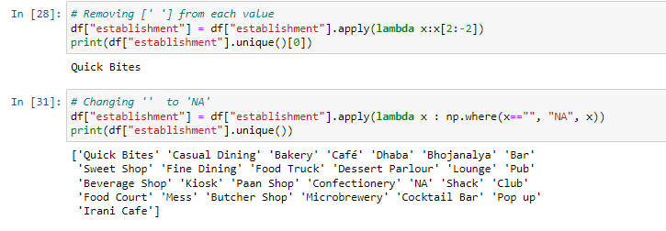
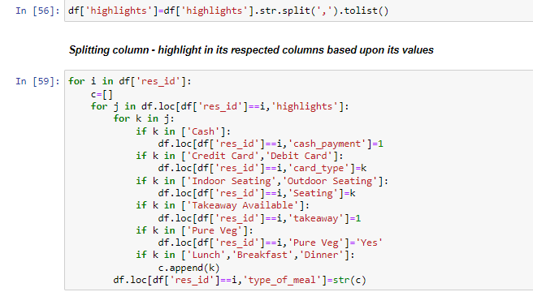
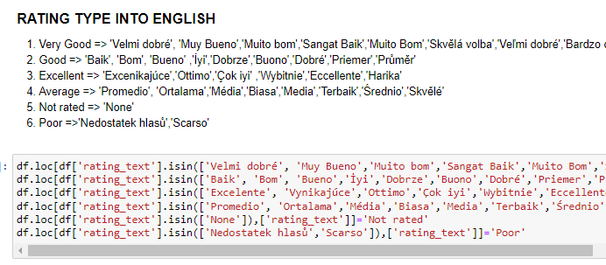
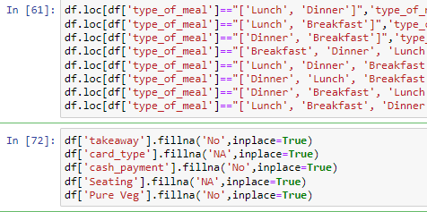
Data Wrangling
1. Removing Duplicate
The original Datasets had 200K rows, this data was checked and duplicates were removed based on res_id.
2. Removing Unwanted Columns
Columns - 'url', 'address','zipcode','locality_verbose', 'timings','currency', 'photo_count', 'opentable_support', ,'takeaway','country_id‘
Were dropped as they were not required for our analysis.
3. Formatting
Few columns had data, which had unwanted characters, so those should be removed for efficient analysis

Slide 8
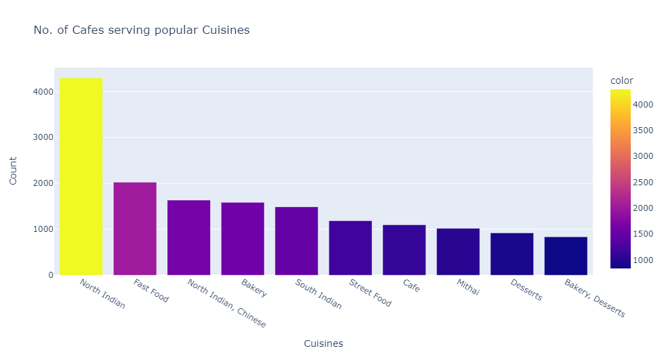
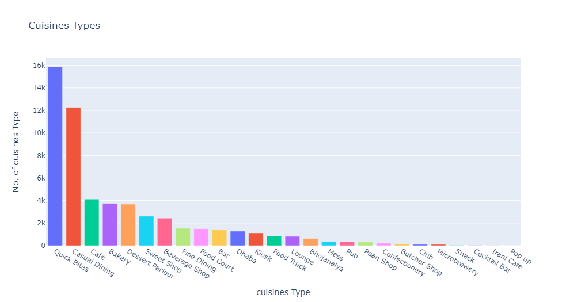
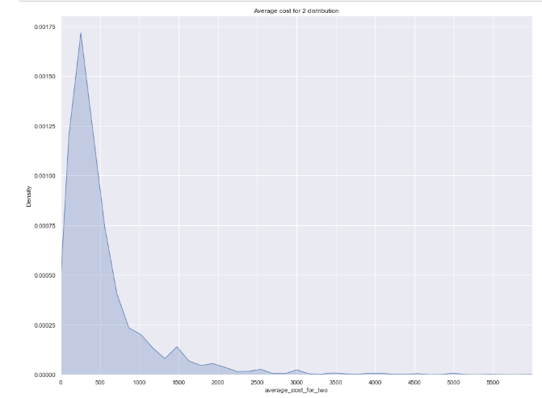
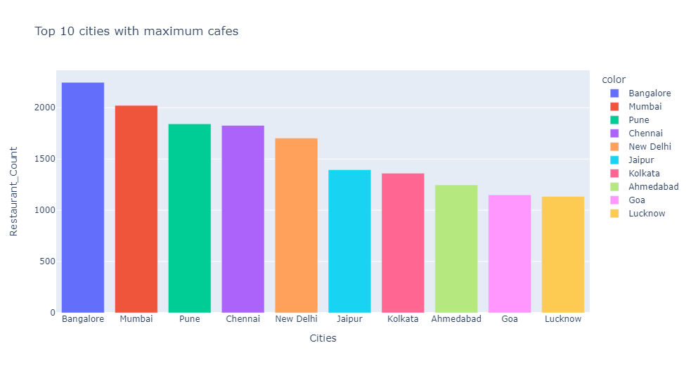
General Exploratory Data Analysis
North Indian Cuisine is the most served Cuisine in India.
Most of the Restaurants are of Quick Bite Types
Metropolitan Cities have higher number of cafes in comparison with other cities
The distribution of the average cost is left – skewed, i.e. more concentrated towards 0-500,
Which signifies, most of the cafes in INIDA are in budget

Slide 9
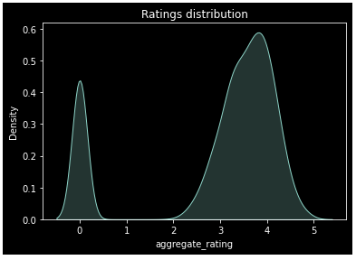
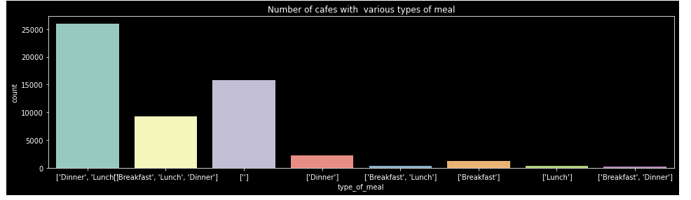
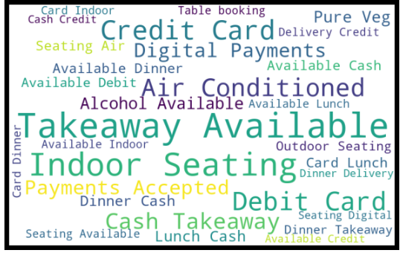
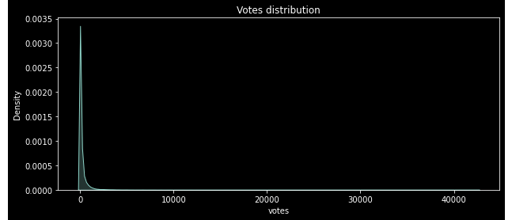
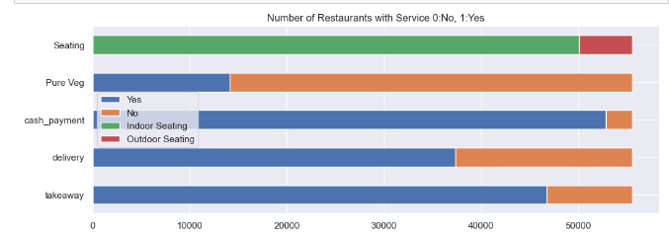
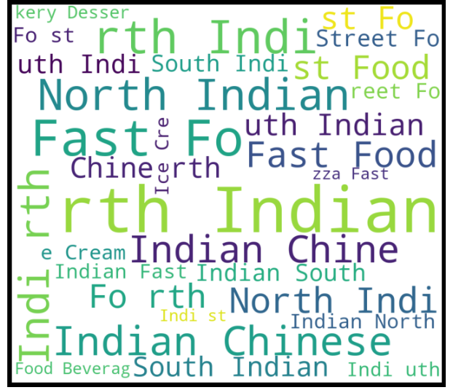
General Exploratory Data Analysis
Most of the cafes received rating between 3-4.5
More than 25K of restaurants serves Dinner and Lunch meals
New Cafes
Except for a few, the votes received by most restaurants are under 300.
Many restaurants provides takeaway, delivery, cash-payment and indoor seating facilities

Slide 10
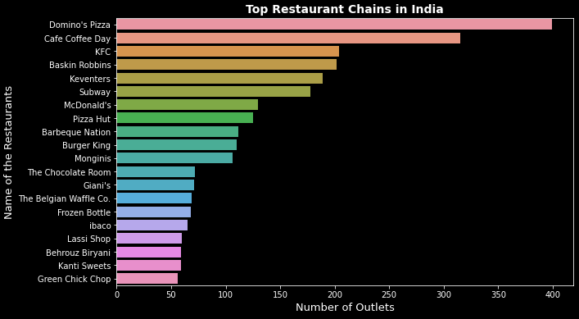
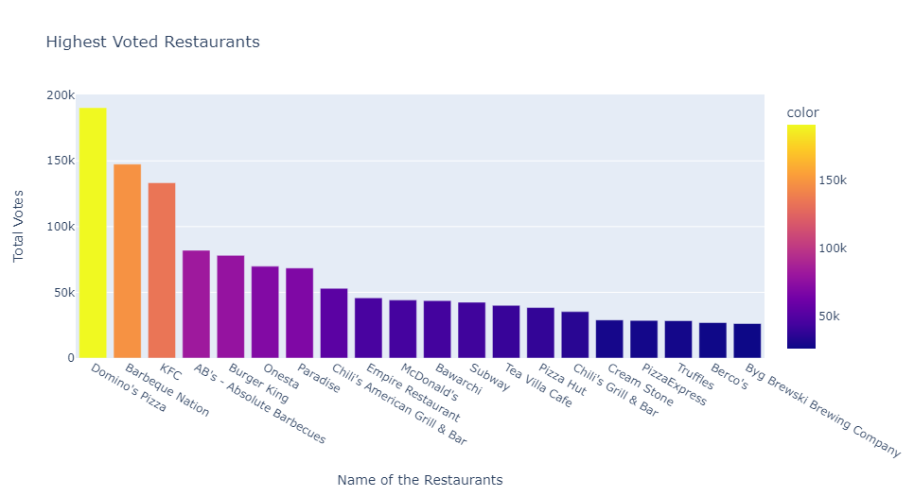
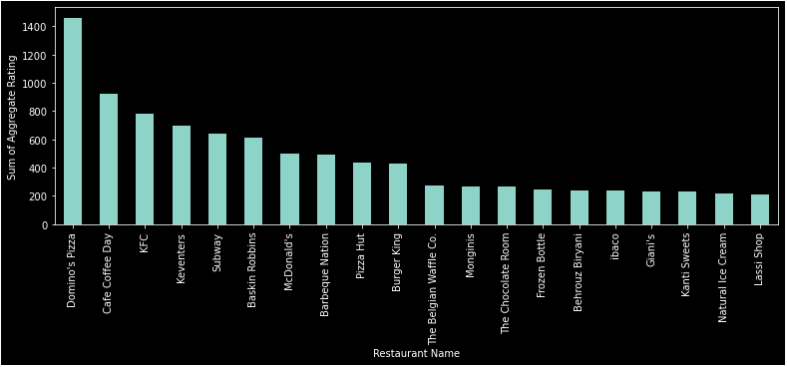
Analysis of Famous Restaurant Chains IN INDIA
Domino’s Pizza holds the rank 1, in all three analysis namely, number of outlets , votes wise or rating wise

Slide 11
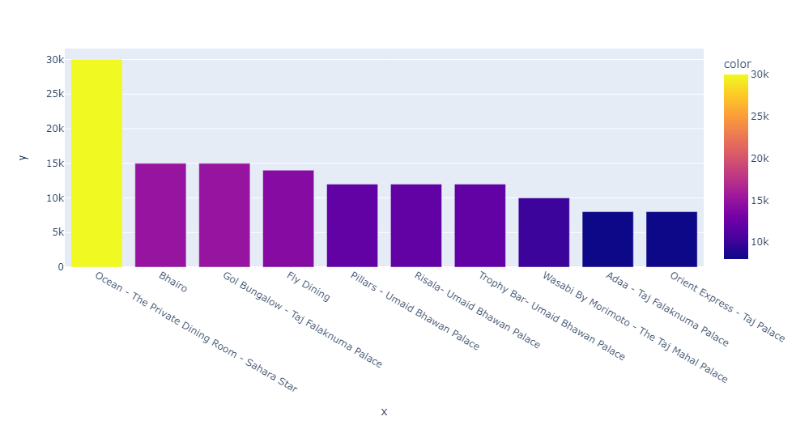
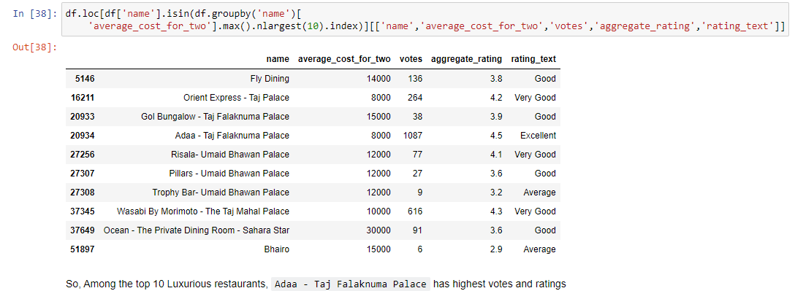
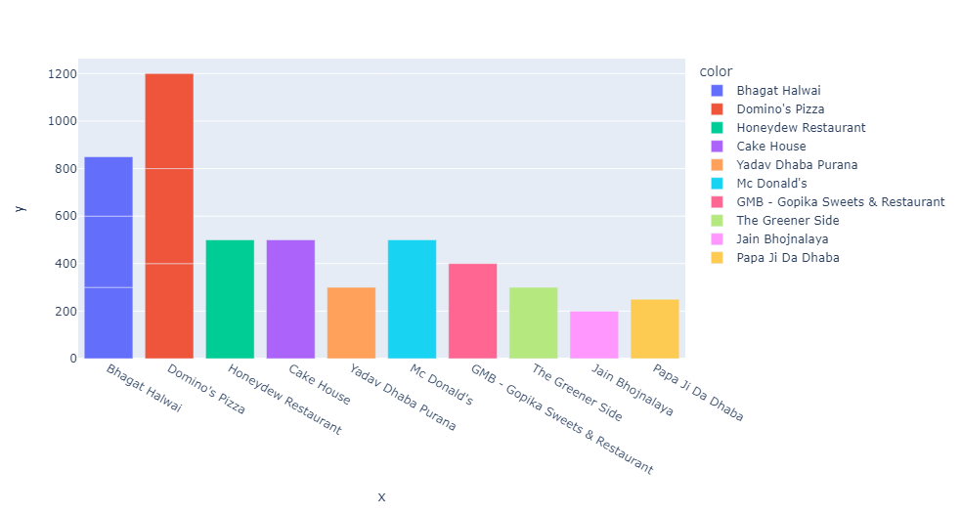
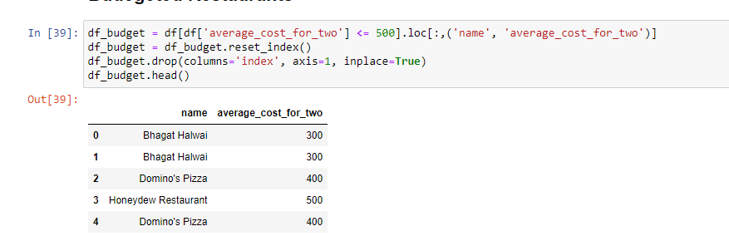
Cost-wise Analysis of restaurants
Top 10 luxurious restaurants in INDIA
Among the top 10 Luxurious restaurants, Adaa - Taj Falaknuma Palace has highest votes and ratings
Affordable Restaurants in INDIA

Slide 12
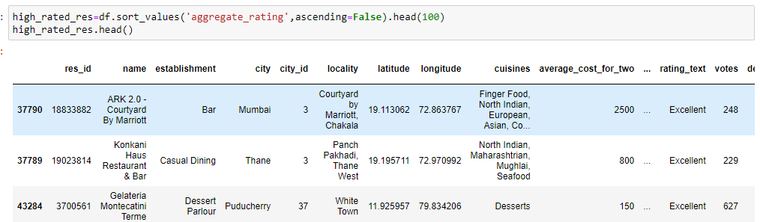
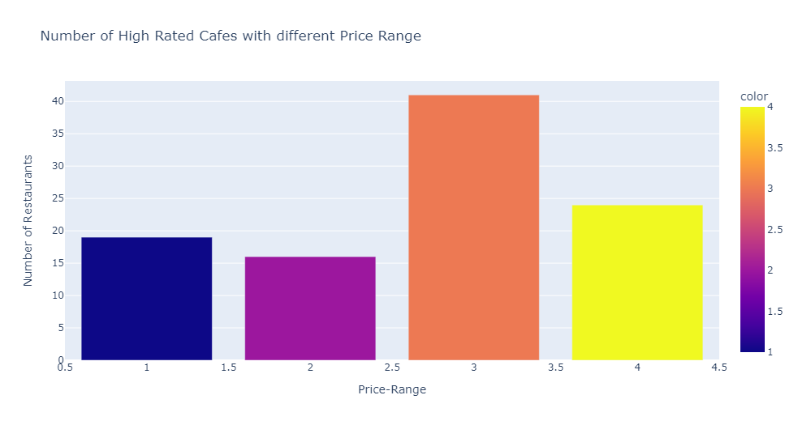
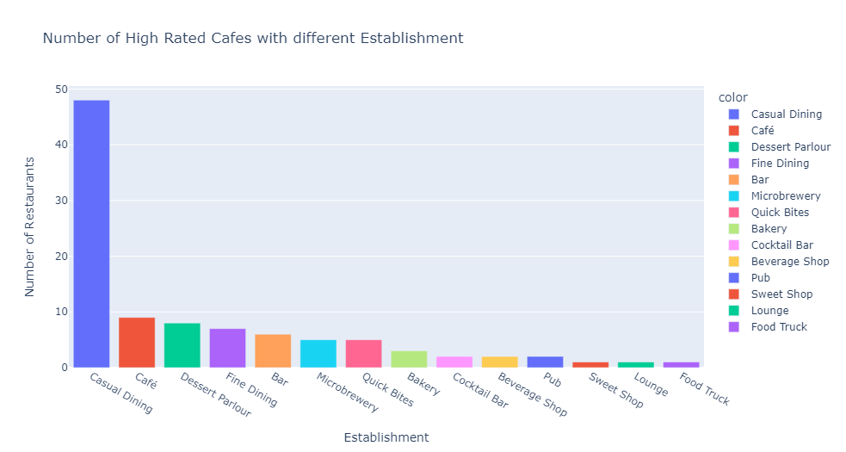
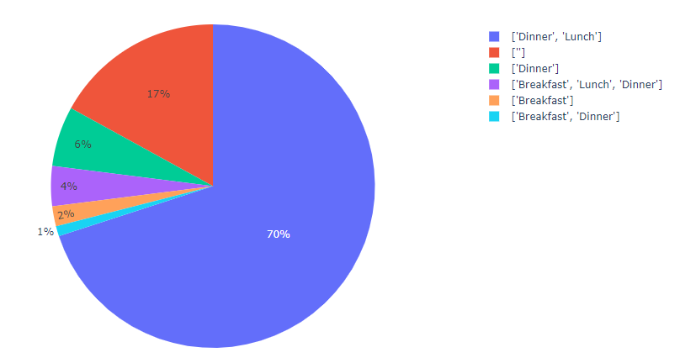
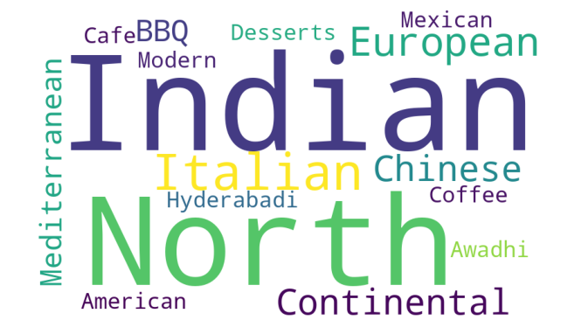
Analysis of HIGH RATED restaurants
Most High rated cafes have price range 3, i.e. of cost1000-1500
Type of Meal
Though we found, the most common establishment type is Quick Bites, but in high rated cafes, it is Casual Dining.

Slide 13
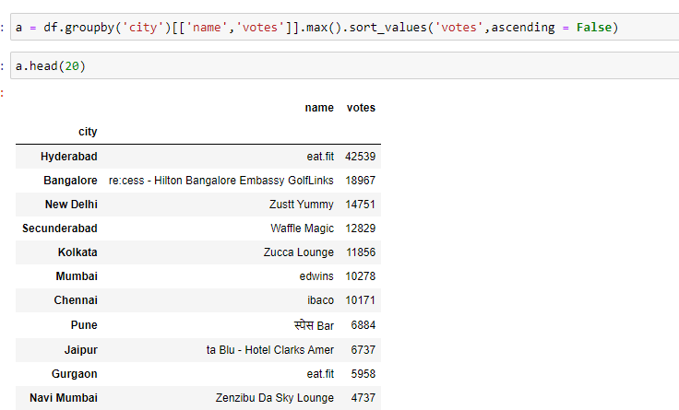
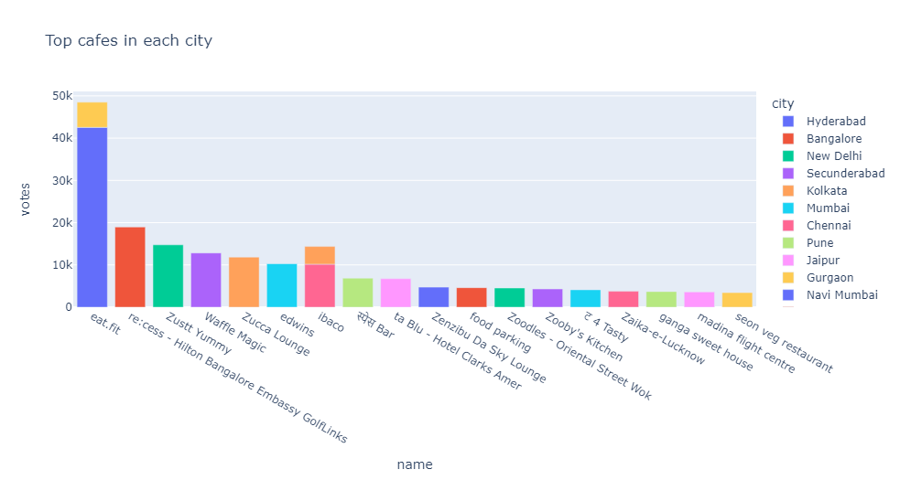
Maximum voted restaurants in Each city
Maximum Voted Cafes In Top 20 Cities

Slide 14
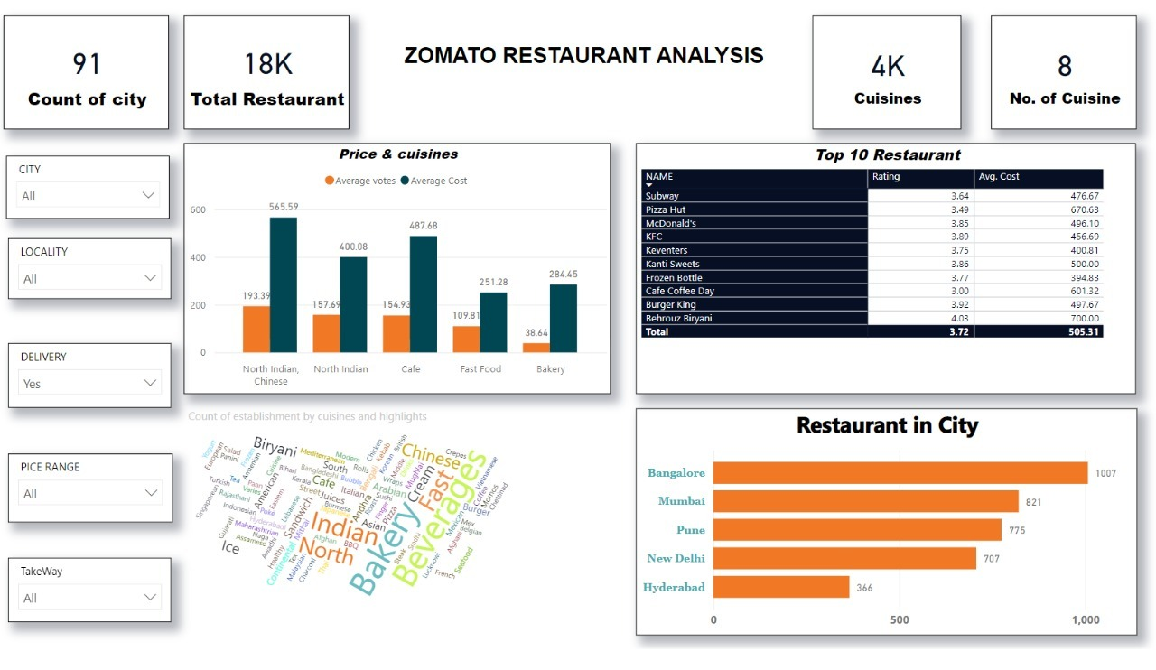
Power Bi DashBoard
https://app.powerbi.com/groups/me/reports/e10e643c-890a-41ac-8123-8effb7155b90/ReportSectionca70692c147928b8b500

Slide 15
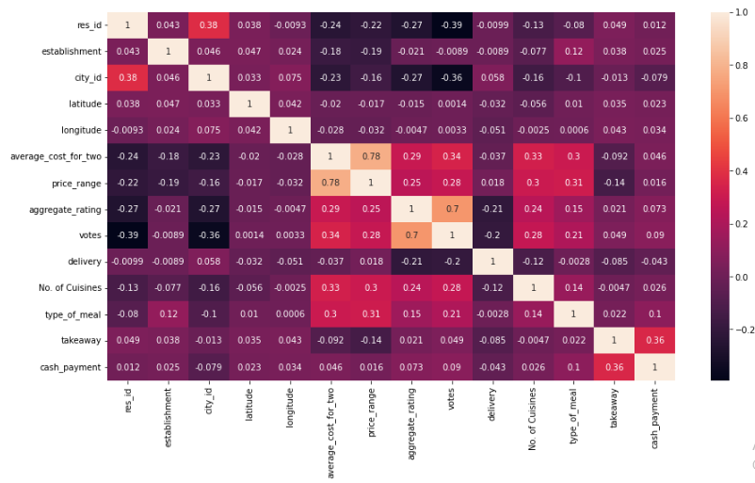
Predictive ANAlysis
Models Used
- Linear Regression
- Decision Tree
- Random Forest
- Extra Tree
Model | R2 Score in Rating Prediction | R2 Score in Cost Prediction
Linear Regression | 0.15192470971168792 | 0.6471499173863282
Decision Tree | 0.8471740590668804 | 0.5314626315091339
Random Forest | 0.8937885887995097 | 0.7158772381253109
Extra Tree | 0.8709824971727094 | 0.6634495084062187

Slide 16
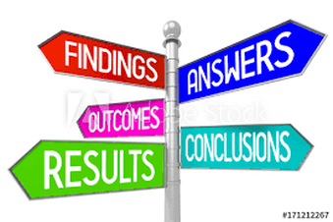
Conclusion
North Indian Cuisine is the most popular and most liked cuisine in INDIA.
India has a higher number of affordable cafes and lower number of Expensive cafes.
Metropolitan Cities have higher number of cafes in comparison with other cities
The maximum number of restaurants are of the Quick Bites Establishment type but higher ratings are given to Casual Dining Type, which means that opening a Casual Dining type restaurant could be profitable.
Dinner and Lunch type of meal is the most commonly served meal.
Among the top 10 Luxurious restaurants, Adaa - Taj Falaknuma is highly rated.
Domino’s Pizza is the most popular restaurant chain in INDIA.

Slide 17


